Slide 1
Introduction to Ethics of Emerging Technologies
What’s at Stake
Ethics and Why It Matters
Ethical Decision-Making in Practice
Causes of Ethical Failures

Slide 2
What’s at Stake
Topic A

Slide 3
Why Ethics Matters
Cases can help highlight the importance of ethical reasoning.
Examples from the real world
Ethical reasoning can:
Prevent adverse outcomes such as harm, conflict, financial loss, and embarrassment.
Address common misconceptions about the ethics of emerging technologies.
Common misconceptions:
Technological progress cannot be controlled.
Ethical problems in technology have straightforward solutions.
Technology is ethically neutral.
Ethics is somebody else’s job.

Slide 4



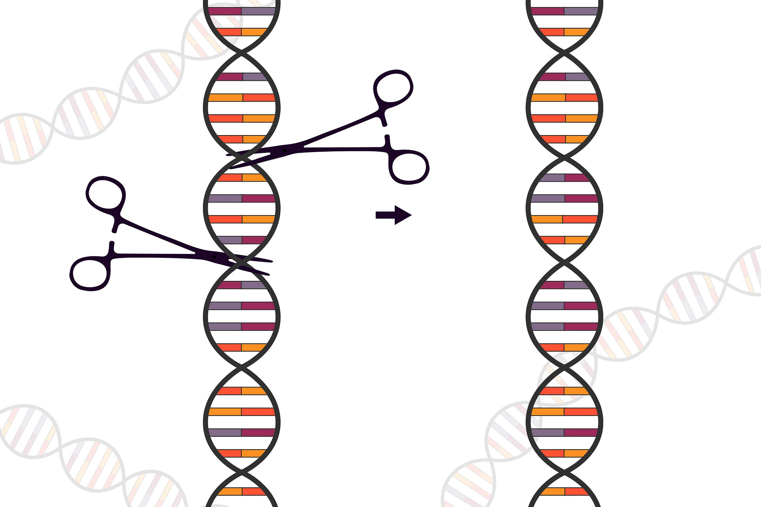


CRISPR Babies: Technology Raises New Ethical Challenges
Product: CRISPR gene editing, which can be used to correct genetic defects, prevent the spread of diseases, and improve crops.
Problem: Researcher He Jiankui used CRISPR for an untested and unauthorized purpose: to edit DNA in human embryos.
Ethical challenges: Whether we should use technology to “customize” babies. Who decides normal function, well-being, and disease?
Lesson: Emerging technologies can generate new ethical challenges that have no established answers. But humans are ultimately responsible for resolving these challenges.

Slide 5

Predpol: Technology Involves Ethical Tradeoffs
Product: Predpol is a tool for predicting incidence of crime to assist police departments in allocating resources efficiently.
Problem: Use of Predpol has led to disproportionate prosecution of petty crimes in neighborhoods that are predominantly poor and Black.
Ethical challenge: Predpol promotes efficiency at the expense of fairness and equality.
By Hubert Guillaud - http://www.internetactu.net/2015/06/23/predpol-la-prediction-des-banalites/, CC BY 3.0, https://commons.wikimedia.org/w/index.php?curid=52644931”
Lesson: Emerging technologies is often not about bad intentions or mistakes—it’s also about navigating value tradeoffs.

Slide 6

Facebook: Context Matters
Product: Facebook, a social network whose mission is to give people the power to build community and bring the world closer together.
Problem: In 2017, the Myanmar military used Facebook to incite murder, rape, and forced migration of the country’s Rohingya minority group.
Ethical challenge: The ethical qualities of a product may vary with context of use.
By Peerapat Wimolrungkarat, Thai Government photographer - [1], CC BY 2.0, https://commons.wikimedia.org/w/index. php?curid=16151919.”
Lesson: Context matters, but this doesn’t mean that tech is always ethically neutral.

Slide 7
Credit Ratings: Democratization or Discrimination?
Product: Credit ratings like FICO were invented in the 1960s to democratize access to credit and prevent discrimination by loan officers.
Problem: Credit ratings have become gatekeepers for life’s necessities, and they are powered by AI that may be biased.
Ethical challenge: Now that credit ratings are so widely used, it is harder to correct their problems.
Source: QuoteInspector.com.
Lesson: If designers and engineers anticipate ethical risks before a product becomes widely adopted, this may be the best chance of mitigating unintended consequences.

Slide 8
Activity: Discussing What’s at Stake
Scenario: General discussion
Which of the cases discussed do you find most disturbing? Why?
In hindsight, sometimes it’s easy to identify what went wrong and to know what should have been done instead. Other times, the complexity of the issues makes it harder to judge what’s right or wrong. Which case do you find most difficult to evaluate? Why?

Slide 9
Ethics and Why It Matters
Topic B

Slide 10
What Is Ethics?
Ethics: The philosophical study of the concepts of moral right and wrong (or moral good and bad).
What is the right thing to do?
Determining the right thing to do in any given case involves a whole lot more than complying with standards set by religious, social, or legal norms. It often involves:
Self-reflection.
Assessing competing principles and goals.
Giving reasons, or justifications, for the decisions we make.
Ethics vs. morality
“Ethics” and “morality” are often used interchangeably.
Ethics is derived from the Greek word “ethos” (character or customary conduct).
Morality is derived from the Latin word “moralis” (manner, custom).

Slide 11





What Ethics Is Not
Questions about ethics arise in many contexts.
As individuals
Businesses, governments, societies, or communities can be ethical as well.
Here are some concepts that are commonly associated with ethics, but aren't the same as ethics:
Law
Cultural Norms
Religion
Emotions
Science

Slide 12



Moral Philosophy
Moral philosophy: The study of ethics.
What elements are involved in doing the right thing?
Metaethics
Normative ethics
Applied ethics
Metaethics
Normative Ethics
Applied Ethics
Are there moral truths?
How should we decide what's the right thing to do?
What should we do in a particular situation?

Slide 13
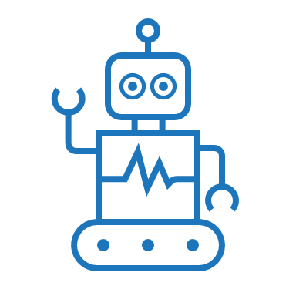


What Are Emerging Technologies?
Emerging technologies: Technologies that are currently being developed or are expected to be available in the near future, and that may have significant economic and social impacts.
The possibility of significant economic and social impact raises ethical questions.
What is the right thing to do?
Responsibility
Innovation

Slide 14
Activity: Identifying Ethical Issues
Scenario: General discussion
Think of a hypothetical personal or business situation where someone faced a difficult ethical choice. What made it difficult?
Think of a hypothetical situation when your judgment about what’s right clashed with a law, policy, or social norm. How did you decide what to do?
Why are ethical considerations so important when it comes to emerging technologies?

Slide 15
Ethical Decision-Making in Practice
Topic C

Slide 16
Facebook Portal: A Case of Racial Bias in AI
Product: Facebook’s Portal Platform: An AI-powered smart camera that follows users’ faces.
Problem: Portal was more likely to follow the faces of white users than of black users.
Moral challenge: The product design contains racial bias. Facebook risks valuing convenience over inclusion and fairness.
Solution: Develop the product with a representative dataset, and create a framework for inclusive AI.

Slide 17



Portal's Tech Specs: An Introduction to AI (Slide 1 of 2)
Artificial Intelligence (AI): The capacity of machines to exhibit human-like intelligence.
Narrow AI solves specific problems.
General AI aims to solve any problem.
Super AI expected to outthink humans.
Machine learning: The processing of large quantities of data by algorithms to make intelligent decisions.
Deep learning: The use of layers of information with increasing complexity (a training model).
Portal used a huge library of mostly white faces for its training model.

Slide 18



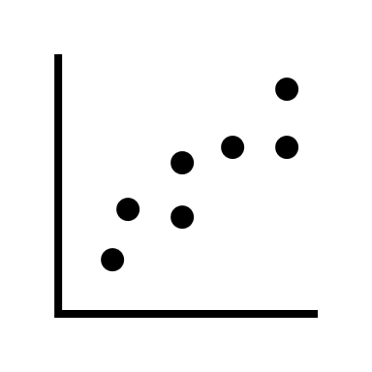



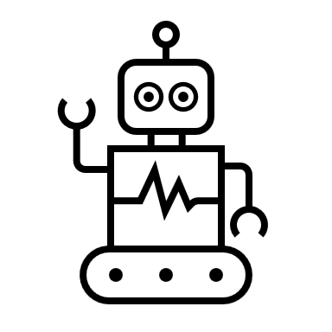








Portal's Tech Specs: An Introduction to AI (Slide 2 of 2)
Data
Training the Algorithm
Building a Model
Predicting Outcomes

Slide 19


Ethical Risks in Product Development
Ethical risk: A potential negative impact on people, society, or the environment.
Products: Commercial and noncommercial applications of an emerging technology.
Ethical reasoning: The practice of weighing relevant reasons before forming judgment.
Decision that might harm people or treat them unequally
Ethical risk
Saving lives?
Making money?
Inclusiveness?
No solution?
A fair product?
Product planning?

Slide 20



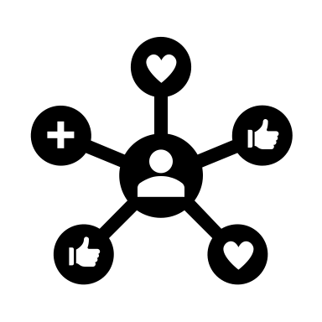
The Price of Ethical Failure
If ethical failure occurs:
Harm
Business loss
Legal penalties
Loss for Society
Developing ethical safeguards is not always easy or cheap, but it is almost always better than paying the price for ethical failure further down the line.

Slide 21
Activity: Discussing Ethical Decision-Making
Scenario: General discussion
In the Portal case, what everyday design decision posed a serious ethical risk?
Have you been involved in any projects where the use of technology introduced ethical risks? How can you guard against these risks?

Slide 22
Causes of Ethical Failures
Topic D

Slide 23
Ethical Failures Due to Bad Intent
Ethical failures: Situations where people or organizations fail to do the right thing and their actions have bad consequences.
Facebook
Cambridge Analytica built psychological profiles of Facebook users without the individuals’ consent.
Cambridge Analytica App
Cambridge Analytica’s business model was premised on user Facebook data without consent, thus intentionally violating privacy standards.
Cambridge Analytica turned the psychological profiles into insights for targeting political advertisements.
Analytics for 2016 presidential campaigns

Slide 24
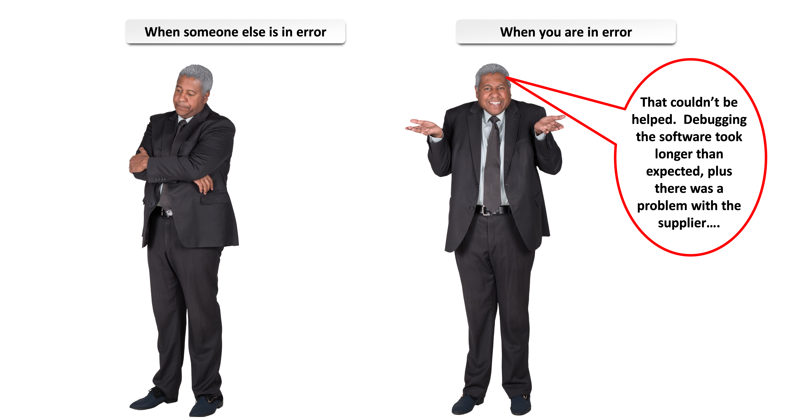
Beware of Ultimate Attribution Error
Ultimate attribution error: The tendency to attribute others’ negative behavior to bad intentions while excusing our own bad behavior as a result of the circumstances.
They don’t care about the impact they are having on their customers. They only go for profit.

Slide 25
Root Causes of Ethical Failure
Root Cause
Example
Intent
Cambridge Analytica
Awareness
Facebook Portal’s Person Recognition
Analysis
Apple vs. the FBI
Governance
YouTube’s Recommender System Feedback Loop
25

Slide 26
Awareness
Recap: Facebook Portal
Detecting the problem is an awareness challenge.
Product: Facebook’s Portal Platform: An AI-powered smart camera that follows users’ faces.
Problem: Portal was more likely to follow the faces of white users than of Black users.
Moral challenge: The product design contains racial bias. Facebook risks valuing convenience over inclusion and fairness.
Solution: Develop product with a representative dataset, and create framework for inclusive AI.

Slide 27
Analysis
Product: Apple’s iPhone security features.
Apple faced a difficult tradeoff that is still controversial today.
Problem: FBI asked Apple to provide technical assistance in accessing the information on a suspected terrorist.
Moral challenge: Weigh the values of safety and security against the privacy of its users.
Privacy
Safety
Safeguard iPhone users against privacy invasions.
Discover threats to national security.

Slide 28
Governance
Governance: The system of rules, practices, and processes by which a firm is directed and controlled.
Product: Youtube’s Recommender System: Directs users to content they will like based on their previous viewing habits and searches, optimized to maximize user engagement time.
Problem: Feedback loops in recommender systems can give rise to “echo chambers,” which can shift the user’s worldview.
Solving the challenge may require a change in success metrics for product teams.
Moral challenge: YouTube’s Recommendation Algorithm has been found to promote terrorist content, extreme hatred, and conspiracy theories.
Solution: Change incentives for product teams: Shift from measuring time spent on YouTube to metrics that take into account what kind of content users interact with.

Slide 29
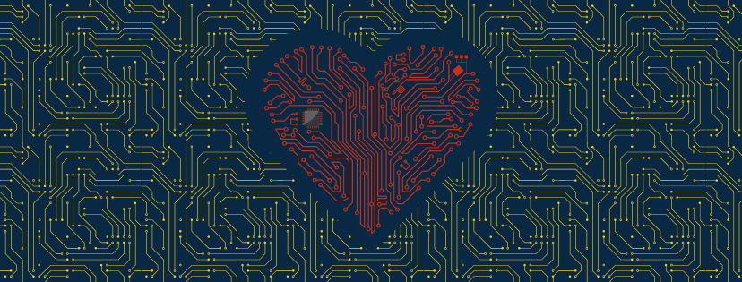
Tech for Good
Each of the root causes of ethical failure can equally be leveraged for doing good.
Two Principles of the Tech for Good Movement
Develop solutions that address social, economic, and environmental challenges.
Build solutions in collaboration with those who will be impacted by it.

Slide 30
Activity: Identifying Causes of Ethical Failures
Scenario: Rudison Technologies.
Research recent examples of ethical failures.
Find a recent case of an ethical failure involving an emerging technology in the news.
Read about the case, and identify the likely root cause(s) of the ethical failure.
Present your findings to the group.
Can you think of an example of a product using emerging technology that uses tech for good?

Slide 31
Can you provide an example of ways that you employ ethical reasoning in your day-to-day life?
You looked at quite a few different cases where ethical issues arose surrounding the use of emerging technologies. If you have witnessed any similar situations at your workplace, what do you think were the underlying causes of the ethical issues?

